Slide 1
The Battle of Neighborhoods Finding a Better Place in Scarborough, Toronto
Final Report - Capstone Project

Slide 2
Introduction
Migration to Canada
Explore better facilities in neighborhood
Cafe, School, Supermarket, medical shops, grocery shops, mall, theatre, hospital, like minded people, etc.
This Project aim to create an analysis of features for a people migrating to Scarborough to search a best neighborhood as a comparative analysis between neighborhoods. The features include median housing price and better school according to ratings, crime rates of that particular area, road connectivity, weather conditions, good management for emergency, water resources both fresh and waste-water and excrement conveyed in sewers and recreational facilities.

Slide 3
FourSquare API
Choosing a radius of 100m for every location.
The data retrieved from Foursquare contained information of venues within a specified distance of the longitude and latitude of the postcodes. The information obtained per venu as follows:
Neighborhood
Neighborhood Latitude
Neighborhood Longitude
Venue
Name of the venue e.g. the name of a store or restaurant
Venue Latitude
Venue Longitude
Venue Category

Slide 4
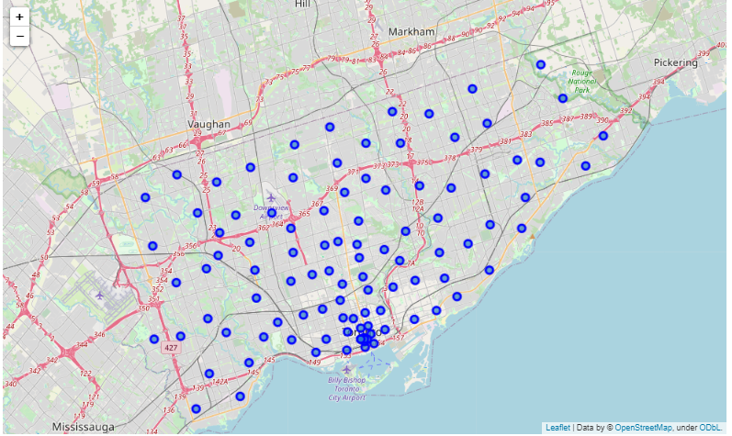
Map of Scarborough

Slide 5
Methodology
Clustering - To compare the similarities of two cities, we decided to explore neighborhoods, segment them, and group them into clusters to find similar neighborhoods in a big city like New York and Toronto. To be able to do that, we need to cluster data which is a form of unsupervised machine learning: k-means clustering algorithm
K-means clustering - Using credentials of Foursquare API features of near-by places of the neighborhoods would be mined. Due to http request limitations the number of places per neighborhood parameter would reasonably be set to 100 and the radius parameter would be set to 500.

Slide 6
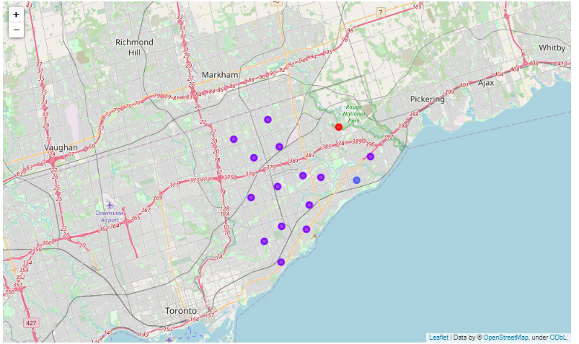
Result – Clusters in Scarborough

Slide 7
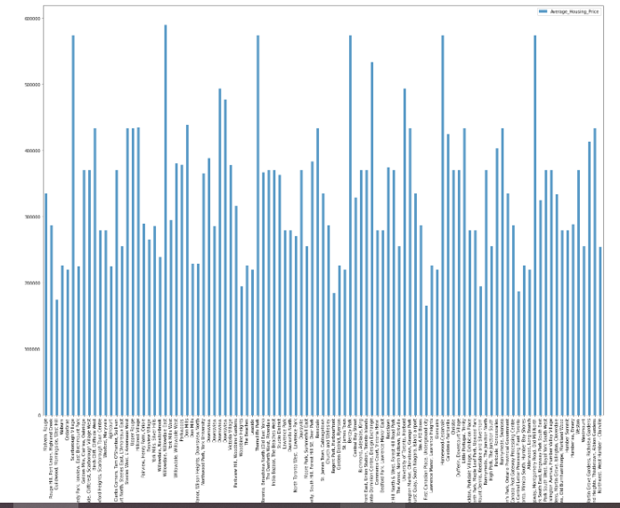
Result – Avg House Price per cluster

Slide 8
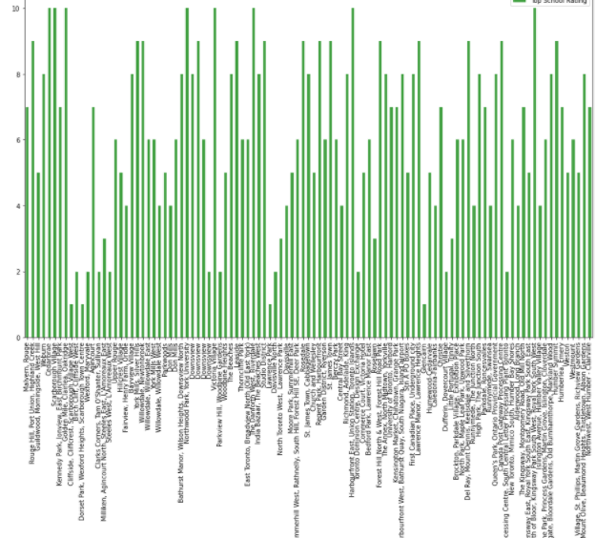
Result – School Rating by cluster

Slide 9
Conclusion
In this project, using k-means cluster algorithm I separated the neighborhood into 10 different clusters and for 103 different latitude and longitude from dataset, which have very-similar neighborhoods around them.
Using the charts above results presented to a particular neighborhood based on average house prices and school rating have been made.

